Slide 1
TIME SERIES ANALYSIS
Shehla Ahmad

Slide 2
Introduction to Time Series Analysis
Time series data often arise when monitoring industrial processes or tracking corporate business metrics. The essential difference between modeling data via time series methods or using the process monitoring methods discussed earlier in this chapter is the following:
Time series analysis accounts for the fact that data points taken over time may have an internal structure (such as autocorrelation, trend or seasonal variation) that should be accounted for.

Slide 3
The method we generally use for forecasting and predicting usually deals with time-based data that is nothing but “Time Series Data” & the models we build for that is “Time Series Modeling”.
As the name indicates, it’s basically working on time (years, days, hours, and minutes) based data, to explore hidden insights of the data and trying to understand the unpredictable nature of the market which we have been attempting to quantify.

Slide 4
The time series data used to provide visual information to the unpredictable nature of the market we have been attempting to quantify and trying to get a grip on that.
An Ordered sequence of observations of a variable or captured object at equally distributed time interval. Time series is anything which is observed sequentially over the time at regular interval like hourly, daily, weekly, monthly, quarterly etc. Time series data is important when you are predicting something which is changing over the time using past data. In time series analysis the goal is to estimate the future value using the behaviours in the past data.

Slide 5
Applications
The usage of time series models is twofold:
Obtain an understanding of the underlying forces and structure that produced the observed data
Fit a model and proceed to forecasting, monitoring or even feedback and feedforward control.
Time Series Analysis is used for many applications such as:
Economic Forecasting
Sales Forecasting
Budgetary Analysis
Stock Market Analysis
Yield Projections
Process and Quality Control
Inventory Studies
Workload Projections
Utility Studies
Census Analysis etc.

Slide 6
Techniques of Forecasting
There are many statistical techniques available for time series forecast however we have found few effectives ones which are listed below:
Simple Moving Average (SMA)
Exponential Smoothing (SES)
Autoregressive Integration Moving Average (ARIMA)
Neural Network (NN)
Croston
For this course we’ll just go through first two methods

Slide 7
METHOD-I: SIMPLE MOVING AVERAGE (SMA)
A simple moving average (SMA) is the simplest type of technique of forecasting. Basically, a simple moving average is calculated by adding up the last ‘n’ period’s values and then dividing that number by ‘n’. So the moving average value is considering as the forecast for next period.
Why Do We Use SMA?
Moving averages can be used to quickly identify whether selling is moving in an uptrend or a downtrend depending on the pattern captured by the moving average.
i.e. A moving average is used to smooth out irregularities (peaks and valleys) to easily recognize trends.
SMA Working Example:
Let us suppose, we have a time series data, to have a better understanding on SMA, Where, we have the graphical view of our data, in that we have twelve observations of Price with equal interval of time. After plotting our data, it seems that it has upward trend with lot of peaks and valleys.

Slide 8
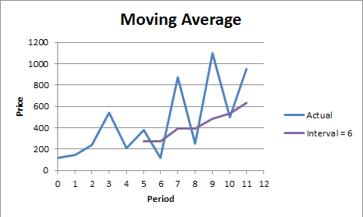
Conclusion: The larger the interval, the more the peaks, and valleys are smoothed out. The smaller the interval, the closer the moving averages are to the actual data points. The SMA is basically deal with historical data having more and more peak and valleys. Probably it would be stock data, retail data etc.

Slide 9
METHOD-II: Exponential Smoothing
This is the second well known method to produce a smoothed Time Series. Exponential Smoothing assigns exponentially decreasing weights as the observation get older.
Why Do We Use Exponential Smoothing?
Exponential smoothing is usually a way of “smoothing” out the data by removing much of the “noise” (random effect) from the data by giving a better forecast.
Types of Exponential Smoothing Methods
Simple Exponential Smoothing: –
If you have a time series that can be described using an additive model with constant level and no seasonality, you can use simple exponential smoothing to make short-term
forecast.
Holt’s Exponential Smoothing: –
If you have a time series that can be described using an additive model with increasing or decreasing trend and no seasonality, you can use Holt’s exponential smoothing to make
short-term forecasts.
Winters’ Three Parameter Linear and Seasonal Exponential Smoothing: –
If you have a time series that can be described using an additive model with increasing or decreasing trend and seasonality, you can use Holt-Winters exponential smoothing to make short-term forecasts.

Slide 10
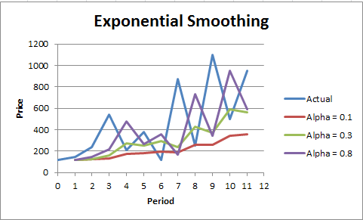
Graphical View
Here, we have alpha value that is smoothing constant and this method is called simple exponential smoothing method which consider other two factors as constant (i.e. Seasonality & Trend). Double’s (Holt’s) Exp. Smoothing & Winter’s Exp. Smoothing Methods dealing two factors i.e. Trend and Seasonality (i.e. Beta & Gamma).
Conclusion: Larger the alpha, closer to the actual data points and vice versa. This method is suitable for forecasting data with no trend or seasonal pattern (alpha = Smoothing Constant).

